Slide 1

Web Components with Angular
@Sherrrylst

Slide 2







Hello!
I’m Sherry List
Azure Developer Technical Lead, Microsoft
Women Techmaker Lead
You can find me at @SherrryLst

Slide 3
Angular Components
@Sherrrylst

Slide 4
Angular Components
Web components
@Sherrrylst

Slide 5
Angular Components
Web components
Angular Elements
@Sherrrylst

Slide 6
Angular Components
Web components
Angular Elements
What’s next?
@Sherrrylst

Slide 7

(Angular) Components
@Sherrrylst

Slide 8
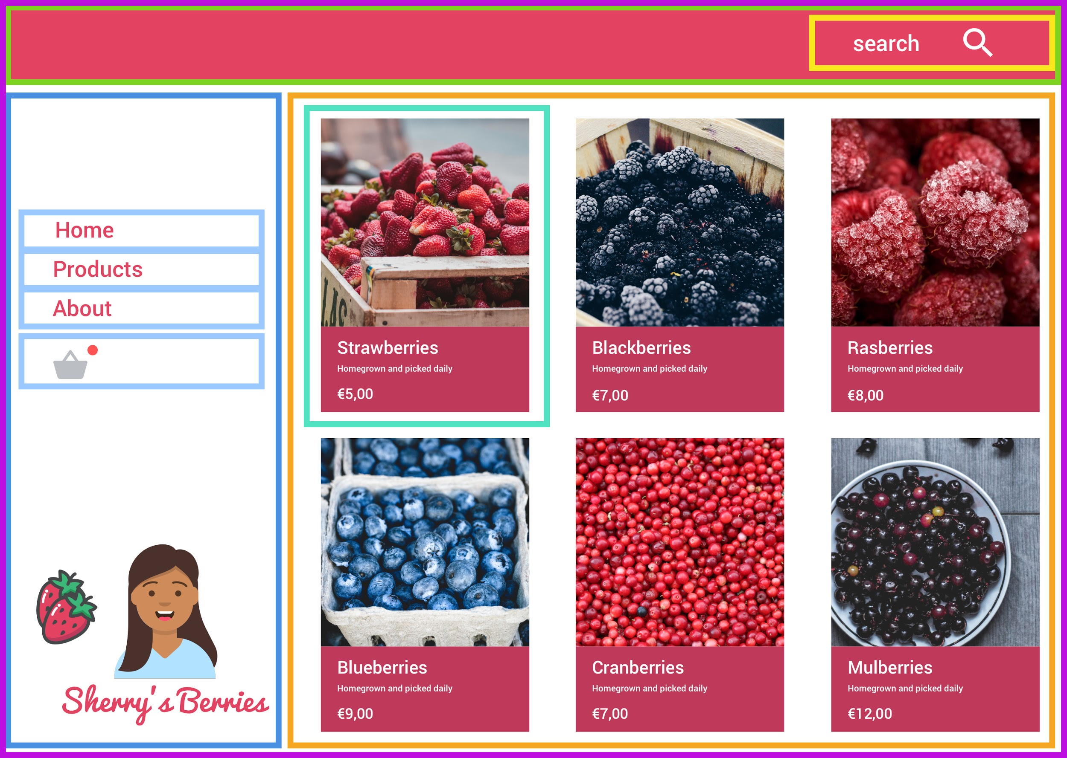
@Sherrrylst

Slide 9

What’s missing:
Actual style encapsulation (nothing leaks in or out without being explicitly allowed)
@Sherrrylst
Notes:
BEM

Slide 10
What’s missing:
Actual style encapsulation (nothing leaks in or out without being explicitly allowed)
Ways of allowing some styling of these elements
@Sherrrylst
Notes:
Allow customising. Theming

Slide 11
What’s missing:
Actual style encapsulation (nothing leaks in or out without being explicitly allowed)
Ways of allowing some styling of these elements
Be able to use elements across teams using different frameworks (or none)
@Sherrrylst
Notes:
Angular, Vue

Slide 12
What’s missing:
Actual style encapsulation (nothing leaks in or out without being explicitly allowed)
Ways of allowing some styling of these elements
Be able to use elements across teams using different frameworks (or none)
Create elements declaratively, but still use JS when needed (to filter lists etc) or hook up bindings - maybe something like JSX - we want flexibility, and not another templating language
@Sherrrylst

Slide 13

What does have all these things?
What does?
@Sherrrylst

Slide 14

Web Components
provides a lot of this
@Sherrrylst

Slide 15
A component that is platform agnostic
Their main goal is to encapsulate the code for the components into a nice, reusable package for maximum interoperability.
@Sherrrylst

Slide 16

Check out: https://custom-elements-everywhere.com/
@Sherrrylst

Slide 17

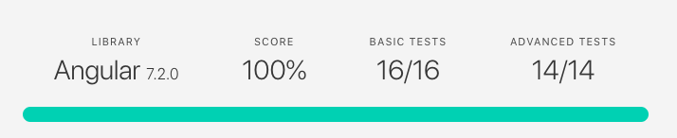
@Sherrrylst

Slide 18

Web components consist of three main technologies:
HTML template
Custom Elements
Shadow DOM
HTML imports
@Sherrrylst
Notes:
HTML imports replaced by ES6 imports and in future we might have HTML modules

Slide 19

Web components consist of three main technologies:
HTML template
<template> </template>
1
@Sherrrylst
Notes:
Not something new been there for a while. It is the template tag. When you use the template tag, you clone it. The difference is as you cloned it, the browser will only parse it once. No matter how many times you use it. Because of that it gains performance.

Slide 20

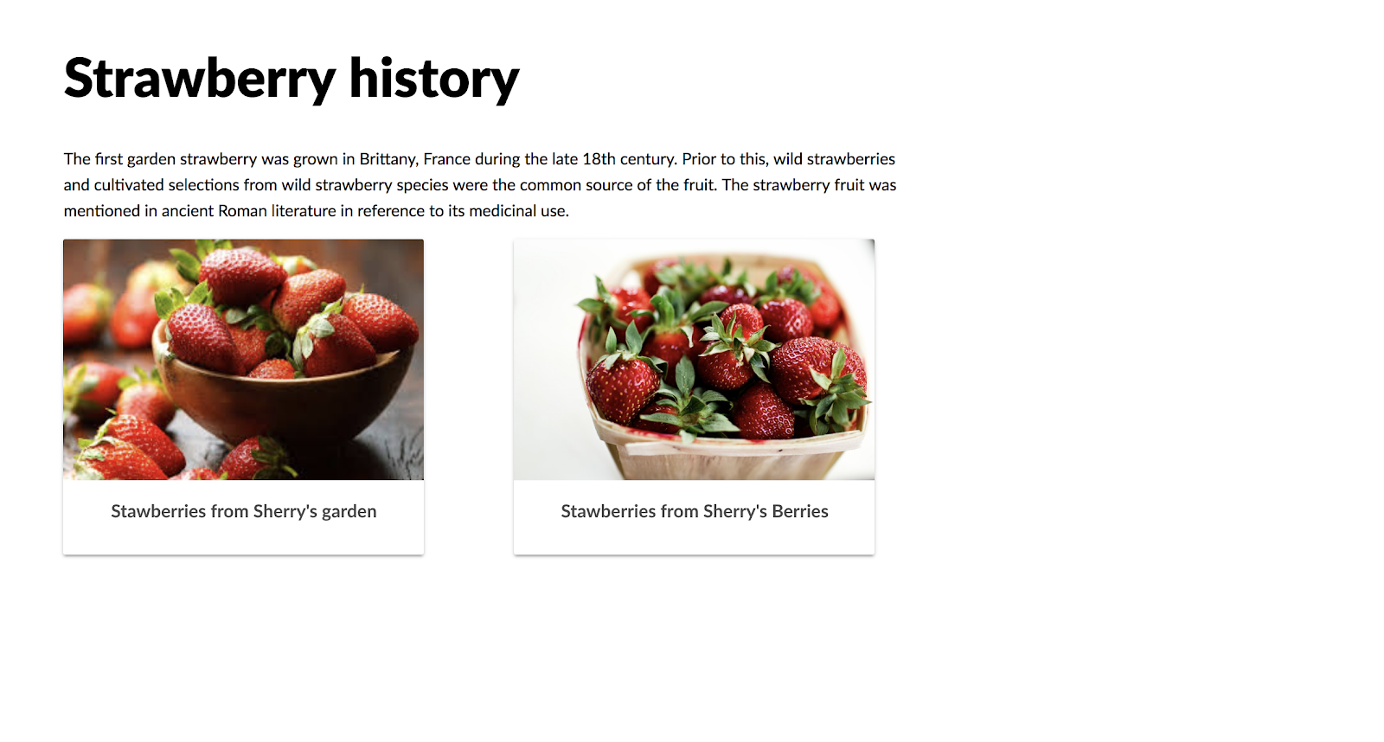
@Sherrrylst

Slide 21
HTML Template
<template id="my-shiny-template">
<div class="template__container">
<img class="template__image">
<div class="template__info">
</div>
</div>
</template>
@Sherrrylst

Slide 22
HTML Template
<div id="image-gallery" class="template__grid">
<!-- existing image containers will be included here -->
</div>
@Sherrrylst

Slide 23
HTML Template
const template = document.querySelector('#red-strawberry-template');
@Sherrrylst

Slide 24
HTML Template
const template = document.querySelector('#red-strawberry-template');
// Add the first image
const imgTag = template.content.querySelector("img");
imgTag.src = "strawberry.jpg";
imgTag.alt = "Strawberries on the table";
@Sherrrylst

Slide 25
HTML Template
const template = document.querySelector('#red-strawberry-template');
// Add the first image
const imgTag = template.content.querySelector("img");
imgTag.src = "strawberry.jpg";
imgTag.alt = "Strawberries on the table";
// Add the first content
const info = template.content.querySelector("span");
info.textContent = "Stawberries from Sherry's garden";
@Sherrrylst

Slide 26
HTML Template
// Clone the new gallery and insert the DOM
const imageGallery = document.querySelector("#image-gallery");
@Sherrrylst

Slide 27
HTML Template
// Clone the new gallery and insert the DOM
const imageGallery = document.querySelector("#image-gallery");
const clone = document.importNode(template.content, true);
@Sherrrylst

Slide 28
HTML Template
// Clone the new gallery and insert the DOM
const imageGallery = document.querySelector("#image-gallery");
const clone = document.importNode(template.content, true);
imageGallery.appendChild(clone);
@Sherrrylst

Slide 29

Why HTML templates?
Browser parse it once
Fast
Easy to use
@Sherrrylst
Notes:
HTML imports replaced by ES6 imports and in future we might have HTML modules

Slide 30

Web components consist of three main technologies:
HTML Template
Custom Elements
2
@Sherrrylst
Notes:
Built on top of ES2015+ classes
Name must include a dash to not conflict with future building elements.
Attributes should be human readable data
Elements inherit from HTMLElement and have a few special methods (attributeChangedCallback, connectedCallback…)

Slide 31
Naming your custom element
<red-button></red-button>
<my-unique-wc></my-unique-wc>
@Sherrrylst

Slide 32
Naming the attributes
<my-unique-wc
title="I am a Title"
xyz="No idea what I am!">
</my-unique-wc>
@Sherrrylst

Slide 33
Custom elements lifecycle
Native | Angular | React | Vue
constructor | ngOnInit | Constructor | Creates
connectedCallback | ngAfterContentChecked | componentDidMount | mounted
disconnectedCallback | ngOnDestroy | componentWillUnmount | destroy
attributeChangedCallback | ngOnChanges | componentDidUpdate | updated
@Sherrrylst
Source: https://youtu.be/j-5uodRMW_Q
Notes:
connectedCallback: Invoked when the custom element is first connected to the document's DOM.
disconnectedCallback: Invoked when the custom element is disconnected from the document's DOM.
attributeChangedCallback: Invoked when one of the custom element's attributes is added, removed, or changed.

Slide 34
Custom elements
<bb-red-strawberry
img="strawberry.jpg"
description="Strawberries from Sherry's Garden">
</bb-red-strawberry>
@Sherrrylst

Slide 35
Custom elements
class BBRedStrawberryElement extends HTMLElement {
constructor() {
super();
}
}
@Sherrrylst

Slide 36
Custom elements
class BBRedStrawberryElement extends HTMLElement {
constructor() {
super();
}
}
// Define custom element
customElements.define("bb-red-strawberry", BBRedStrawberryElement);
@Sherrrylst

Slide 37
Custom elements
connectedCallback() {
this.innerHTML = template;
this._$image = this.querySelector("#element-image");
this._$description = this.querySelector("#element-description");
this._render(this);
}
@Sherrrylst

Slide 38
Custom elements
_render({ img, description }) {
description = description || "Description is missing";
this._$image.alt = description;
this._$image.src = img || "missing-image.jpg";
const figcaption = document.createElement("figcaption");
figcaption.textContent = description;
figcaption["aria-label"] = "product name";
this._$description.appendChild(figcaption);
}
@Sherrrylst

Slide 39
Custom elements
…
static get observedAttributes() {
return ["description", "img"];
}
attributeChangedCallback(name, oldValue, newValue) {
this[name] = newValue;
}
...
@Sherrrylst

Slide 40
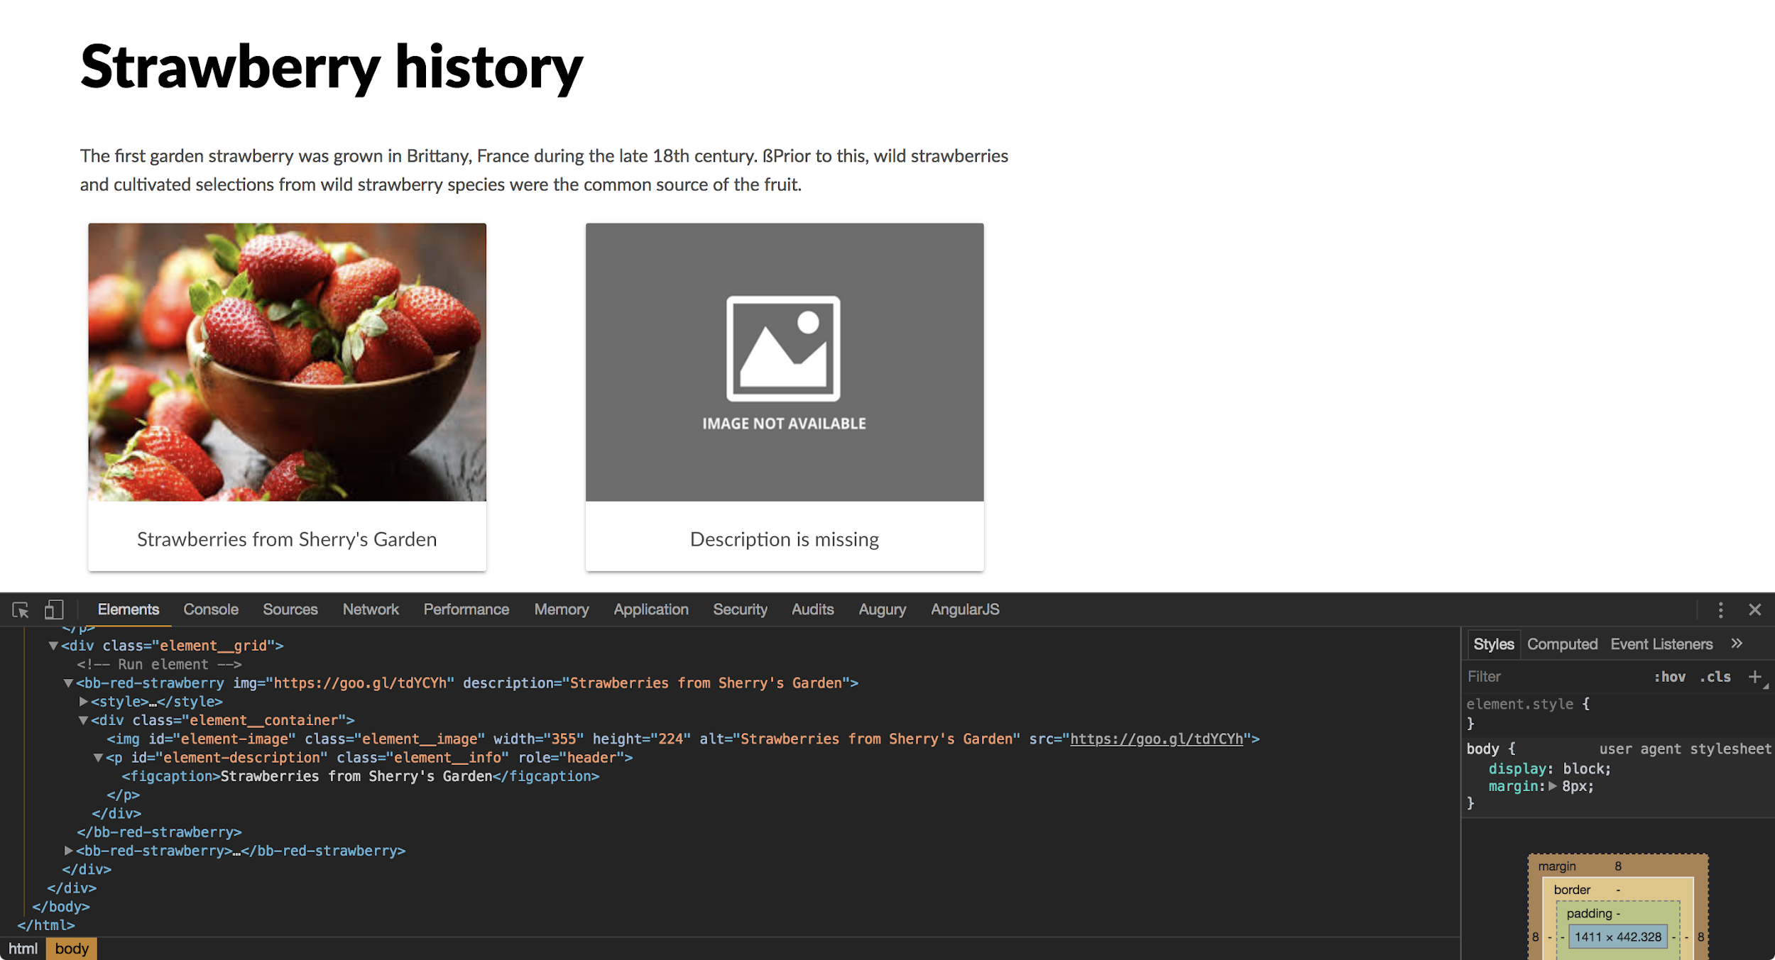

Notes:
What’s the big deal???
Template fixes the existing performance issues with updating DOM elements.
template.content.cloneNode(true) =>
Content represents the DOM we wrapped and we are cloning it at the append time. Every time we append it to the DOM, we are not parsing it or we are not calling JavaScript. We are parsing it for the template once but after time we are not parsing it again!
So, it’s very fast!!!!!

Slide 41

@Sherrrylst

Slide 42
Global CSS
<style>
p {
font-family: 'Lato', sans-serif;
font-size: 0.9em;
max-width: 760px;
line-height: 1.6em;
color: red;
}
@Sherrrylst

Slide 43
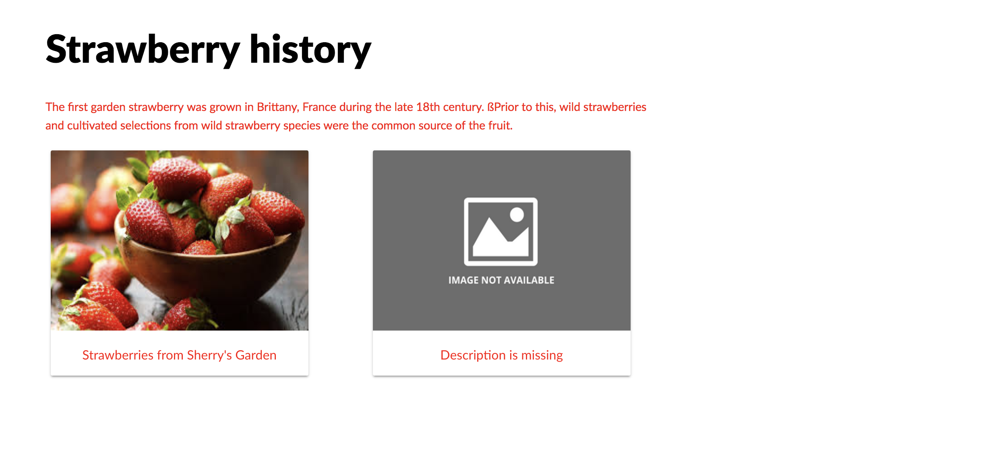
@Sherrrylst

Slide 44

Web components consist of three main technologies:
HTML Template
Custom Elements
Shadow DOM
3
@Sherrrylst

Slide 45
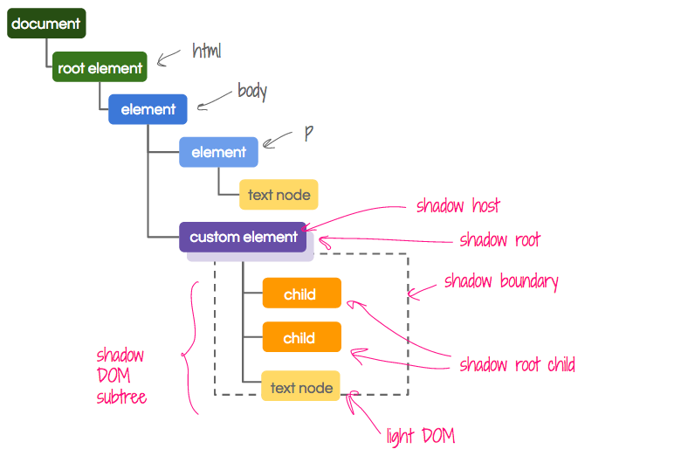
Shadow DOM
https://girliemac.com/presentation-slides/webcomponents/images/dom-tree.png

Slide 46
Shadow DOM
class BBRedStrawberryElement extends HTMLElement {
constructor() {
super();
const template = document.createElement("template");
// Shadow DOM
this.attachShadow({ "mode": "open" });
this.shadowRoot.appendChild(template.content.cloneNode(true));
}
@Sherrrylst

Slide 47

Slots
@Sherrrylst

Slide 48
Shadow DOM
@Sherrrylst

Slide 49
Template
...
<img id="shadow-image" class="shadow__image">
<div id="shadow-info" class="shadow__info">
<slot name="title" id="title" role="header" class="shadow__title"></slot>
<slot name="description" id="description" class="shadow__description"></slot>
</div>
...
@Sherrrylst

Slide 50
Custom Element
<bb-red-strawberry
img="strawberry.jpg">
<div slot="title"><i>Strawberries</i></div>
<div slot="description">Sherry's berries finest strawberries</div>
</bb-red-strawberry>
@Sherrrylst

Slide 51

CSS Custom Properties
@Sherrrylst

Slide 52
Shadow DOM
@Sherrrylst

Slide 53
Template
<style>
.container {
width: 320px;
height: 280px;
background-color: var(--background-color, #fff);
}
<style>
@Sherrrylst

Slide 54
CSS custom properties
<bb-red-strawberry
img="strawberry.jpg"
style="--background-color: #A11B38;">
<div slot="title"><i>Strawberries</i></div>
<div slot="description">Sherry's berries finest strawberries</div>
</bb-red-strawberry>
@Sherrrylst

Slide 55

Remember:
Documentation
@Sherrrylst

Slide 56

:host
@Sherrrylst

Slide 57
Template
<style>
:host(bb-red-strawberry) {
/* Applies if the host is a <bb-red-strawberry> element.*/
font-weight: bold;
width: 320px;
height: 280px;
background-color: var(--background-color, #fff);
box-shadow: 0 2px 2px 0 rgba (0, 0, 0, .14);
border-radius: 2px;
}
<style>
@Sherrrylst

Slide 58
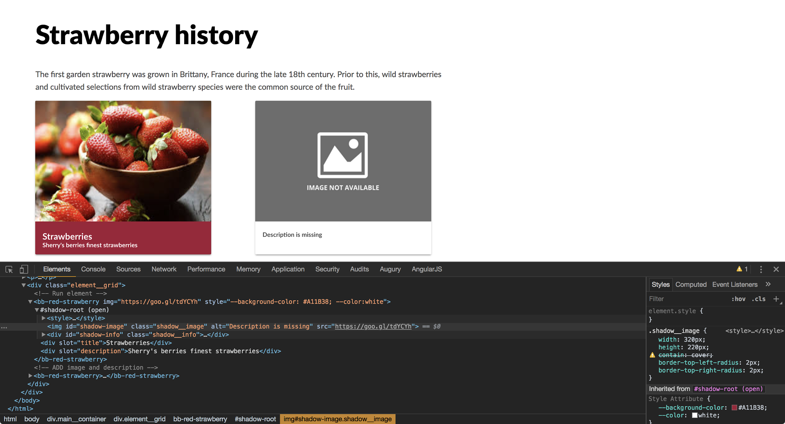

Slide 59

@Sherrrylst

Slide 60
Global CSS
<style>
p {
font-family: 'Lato', sans-serif;
font-size: 0.9em;
max-width: 760px;
line-height: 1.6em;
color: red;
}
@Shrrrylst
@Sherrrylst

Slide 61
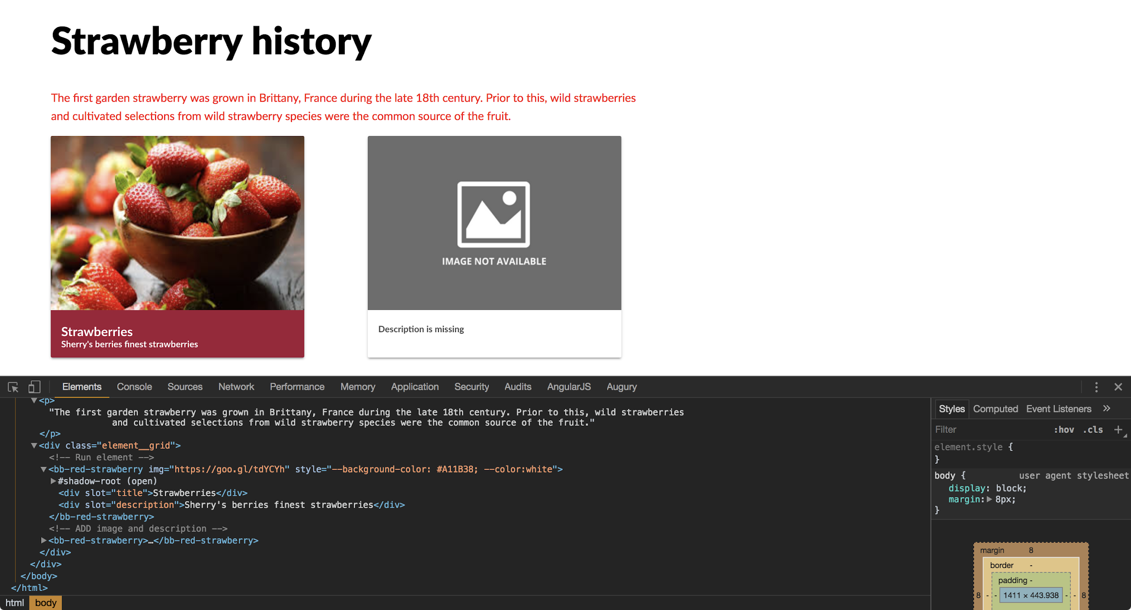

Slide 62

We made it!
@Sherrrylst

Slide 63

@Sherrrylst

Slide 64
Angular Elements
@Sherrrylst

Slide 65
terminal
npm i -g @angular/cli
@Sherrrylst

Slide 66
terminal
npm i -g @angular/cli
ng new bb-card --prefix bb --inline-template --style=scss
@Sherrrylst

Slide 67
terminal
npm i -g @angular/cli
ng new bb-card --prefix bb --inline-template --style=scss
cd bb-card
@Sherrrylst

Slide 68
terminal
npm i -g @angular/cli
ng new bb-card --prefix bb --inline-template --style=scss
cd bb-card
ng add @angular/elements
@Sherrrylst

Slide 69
terminal
npm i -g @angular/cli
ng new bb-card --prefix bb --inline-template --style=scss
cd bb-card
ng add @angular/elements
npm install @webcomponents/custom-elements --save
@Sherrrylst

Slide 70
polyfills.ts
import '@webcomponents/custom-elements/custom-elements.min';
@Sherrrylst

Slide 71
tsconfig.json
{
"compileOnSave": false,
"compilerOptions": {
…
"target": "es2015",
….
}
}
}
@Sherrrylst
Notes:
In browsers that support Custom Elements natively, the specification requires developers use ES2015 classes to define Custom Elements - developers can opt-in to this by setting the target: "es2015" property in their project's tsconfig.json.

Slide 72
terminal
ng generate component card
@Sherrrylst
Notes:
--view-encapsulation

Slide 73
card.component.ts
import { Component, OnInit } from '@angular/core';
@Component({
selector: 'bb-card',
template: ` ...`,
styleUrls: ['./bb-card.scss'],
})
export class CardComponent implements OnInit {
constructor() { }
ngOnInit() {}
}
@Sherrrylst

Slide 74

Look back...
@Sherrrylst

Slide 75
Web component (Native)
class BBRedStrawberryElement extends HTMLElement {
constructor() {
super();
const template = document.createElement("template");
this.attachShadow({ "mode": "open" });
this.shadowRoot.appendChild(template.content.cloneNode(true));
}
customElements.define("bb-red-strawberry", BBRedStrawberryElement);

Slide 76
Web component (Native)
class BBRedStrawberryElement extends HTMLElement {
constructor() {
super();
const template = document.createElement("template");
this.attachShadow({ "mode": "open" });
this.shadowRoot.appendChild(template.content.cloneNode(true));
}
customElements.define("bb-red-strawberry", BBRedStrawberryElement);

Slide 77
ViewEncapsulation.ShadowDom
This encapsulation mode uses the Shadow DOM to scope styles only to this specific component.
@Sherrrylst

Slide 78
card.component.ts
import { Component, OnInit, ViewEncapsulation, Input } from '@angular/core';
@Component({
selector: 'bb-card',
template: ` ...`,
styleUrls: ['./bb-card.scss'],
encapsulation: ViewEncapsulation.ShadowDom
})
@Sherrrylst

Slide 79
Make our code Angular friendly
@Sherrrylst

Slide 80
card.component.ts
template: `
<img id='shadow-image' class='shadow__image' src=‘{{ img }}' alt='title'>
<div id='shadow-info' class='shadow__info'>
<h1 name='title' id='title' role='header' class='shadow__title'>{{ title }}</h1>
<p name='description' id='description' class='shadow__description'>{{ description }}</p>
</div>
`
@Sherrrylst

Slide 81
card.component.ts
export class CardComponent implements OnInit{
@Input() title?: string = 'default title';
@Input() description?: string = 'default description';
@Input() img?: string = 'undefined.png';
constructor() { }
ngOnInit() {}
}
@Sherrrylst

Slide 82
card.component.scss
:host {
display: block;
width: 320px;
height: 300px;
background-color: var(--background-color, #fff);
[...]
.shadow__image {
[...]
}
.shadow__info {
[...]
}
}
@Sherrrylst
Notes:
By default any class that extends HTMLElement is an inline element. But we are changing properties here that require us to be block.

Slide 83
Register our component in NgModule
@Sherrrylst

Slide 84
app.module.ts
import { NgModule, Injector } from '@angular/core';
import { createCustomElement } from '@angular/elements';
@NgModule({
declarations: [ CardComponent ],
imports: [ BrowserModule ],
entryComponents: [ CardComponent ],
})
@Sherrrylst
Notes:
Builds a class that encapsulates the functionality of the provided component and uses the configuration information to provide more context to the class. Takes the component factory's inputs and outputs to convert them to the proper custom element API and add hooks to input changes.

Slide 85
Look back...

Slide 86
Web component (Native)
class BBRedStrawberryElement extends HTMLElement {
constructor() {
super();
const template = document.createElement("template");
this.attachShadow({ "mode": "open" });
this.shadowRoot.appendChild(template.content.cloneNode(true));
}
customElements.define("bb-red-strawberry", BBRedStrawberryElement);

Slide 87
Web component (Native)
class BBRedStrawberryElement extends HTMLElement {
constructor() {
super();
const template = document.createElement("template");
this.attachShadow({ "mode": "open" });
this.shadowRoot.appendChild(template.content.cloneNode(true));
}
// Define custom element
customElements.define("bb-red-strawberry", BBRedStrawberryElement);

Slide 88
app.module.ts
@NgModule({
declarations: [CardComponent],
imports: [BrowserModule],
entryComponents: [CardComponent],
})
export class AppModule {
constructor(private injector: Injector) {
const bbCard = createCustomElement(CardComponent, { injector });
customElements.define('bb-card', bbCard);
}
@Sherrrylst
Notes:
The method createCustomElement wraps the CardComponent so that it looks like a Web Component. Using customElements.define we can register it with the browser.
The configuration’s injector is the initial injector set on the class, and used by default for each created instance.

Slide 89
app.module.ts
@NgModule({
declarations: [CardComponent],
imports: [BrowserModule],
entryComponents: [CardComponent],
})
export class AppModule {
constructor(private injector: Injector) {
const bbCard = createCustomElement(CardComponent, { injector });
customElements.define('bb-card', bbCard);
}
ngDoBootstrap() {}
}
@Sherrrylst
Notes:
We also need to tell Angular to use this module for bootstrapping, hence the ngDoBootstrap method.

Slide 90
terminal
ng build
@Sherrrylst
Notes:
--view-encapsulation

Slide 91
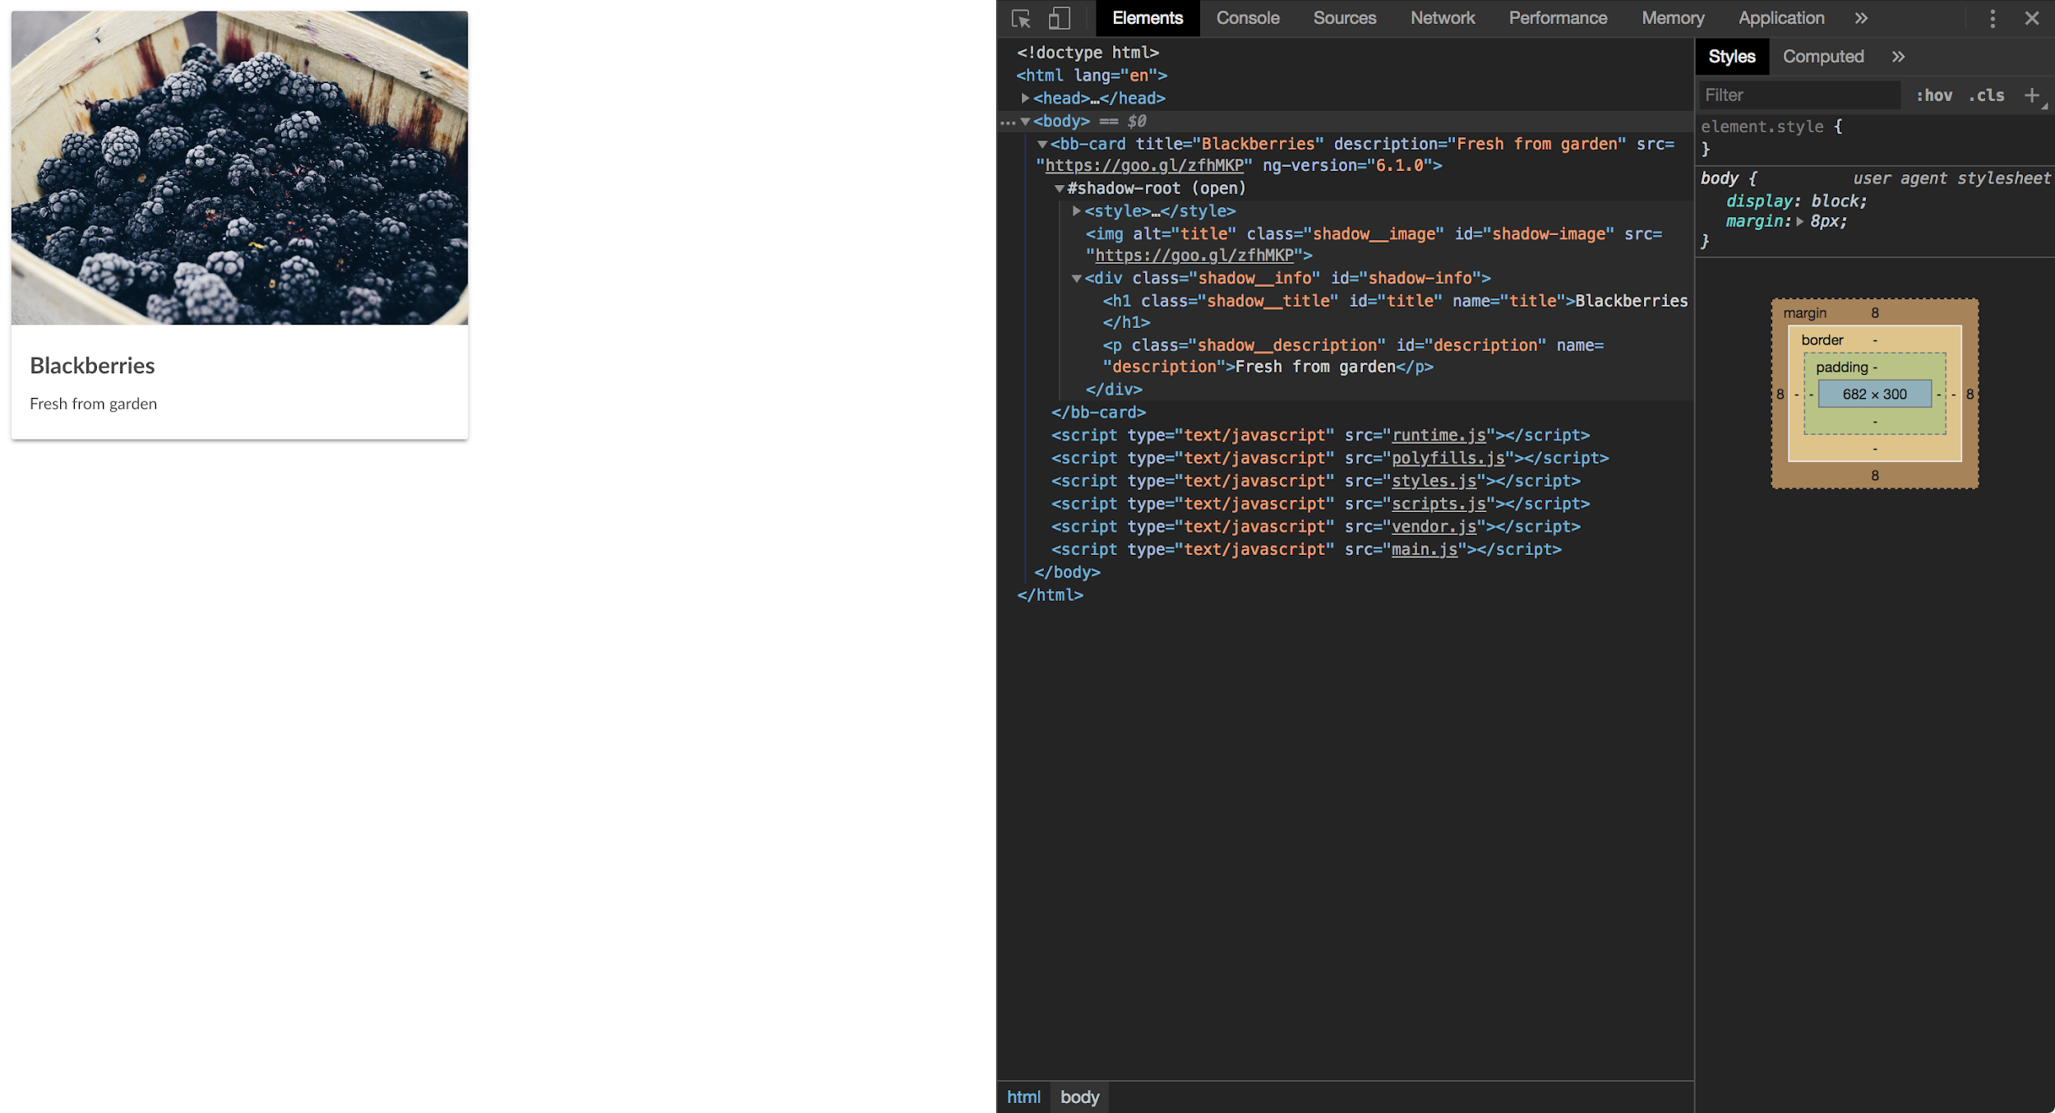

@Sherrrylst

Slide 92

@Sherrrylst

Slide 93
Wait a min
@Sherrrylst

Slide 94

build
@Sherrrylst

Slide 95

It’s not that easy!
Huge bundle size
No support for one bundle
-> Eject
Complicated!
@Sherrrylst

Slide 96

ngx-build-plus
@ManfredSteyer
Check out: https://github.com/manfredsteyer/ngx-build-plus
@Sherrrylst

Slide 97

It’s #awesome!
Extends Cli
No Eject
Build a single bundle
No need to add Angular multiple times to your project
Universal module
@Sherrrylst

Slide 98
terminal
ng add ngx-build-plus
@Sherrrylst
Notes:
--view-encapsulation

Slide 99
angular.json
[...]
"architect": {
"build": {
"builder": "ngx-build-plus:build",
[...]
}
}
[...]
@Sherrrylst
Notes:
We also need to tell Angular to use this module for bootstrapping, hence the ngDoBootstrap method.

Slide 100
webpack.extra.js
module.exports = {
"externals": {
"rxjs": "rxjs",
"@angular/core": "ng.core",
"@angular/common": "ng.common",
"@angular/platform-browser": "ng.platformBrowser",
"@angular/elements": "ng.elements"
}
}
@Sherrrylst
Notes:
We also need to tell Angular to use this module for bootstrapping, hence the ngDoBootstrap method.

Slide 101
terminal
ng build --prod
--extraWebpackConfig webpack.extra.js
--output-hashing none
--single-bundle true
@Sherrrylst
Notes:
--view-encapsulation

Slide 102
Now our component is ready!
@Sherrrylst

Slide 103

Ivy
The new backwards-compatible Angular renderer:
Speed improvements
Bundle size reduction
Increasing flexibility
@Sherrrylst

Slide 104
How do we use it?
@Sherrrylst
Notes:
Add to an existing Angular project!

Slide 105
terminal
npm install @webcomponents/custom-elements --save
@Sherrrylst

Slide 106
polyfills.ts
import '@webcomponents/custom-elements/custom-elements.min';
@Sherrrylst

Slide 107
app.component.ts
import { Component } from '@angular/core';
import * as bbCard from '../web-components/bb-card/bb-card.js';
@Component({
selector: 'berry-root',
template: `
<bb-card
title='Strawberries'
description='Fresh from Sherry garden' img='../assets/images/strawberry-unx.jpeg' style="--background-color: #A11B38; --color: #ffffff;">
loading...
</bb-card>
`',
styleUrls: ['./app.component.css']
})
export class AppComponent {...}
@Sherrrylst

Slide 108
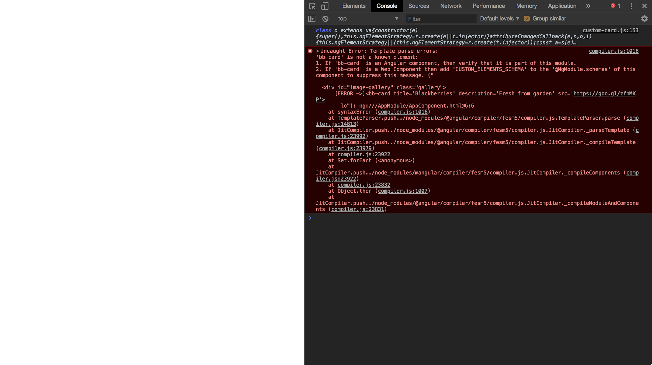
@Sherrrylst

Slide 109
app.module.ts
@NgModule({
[…]
schemas: [
CUSTOM_ELEMENTS_SCHEMA
]
})
export class AppModule {
}
@Sherrrylst
Notes:
As the browser renders it, Angular is not aware of the element name custom-card. To prevent it from throwing an error, we have to use the CUSTOM_ELEMENTS_SCHEMA:

Slide 110
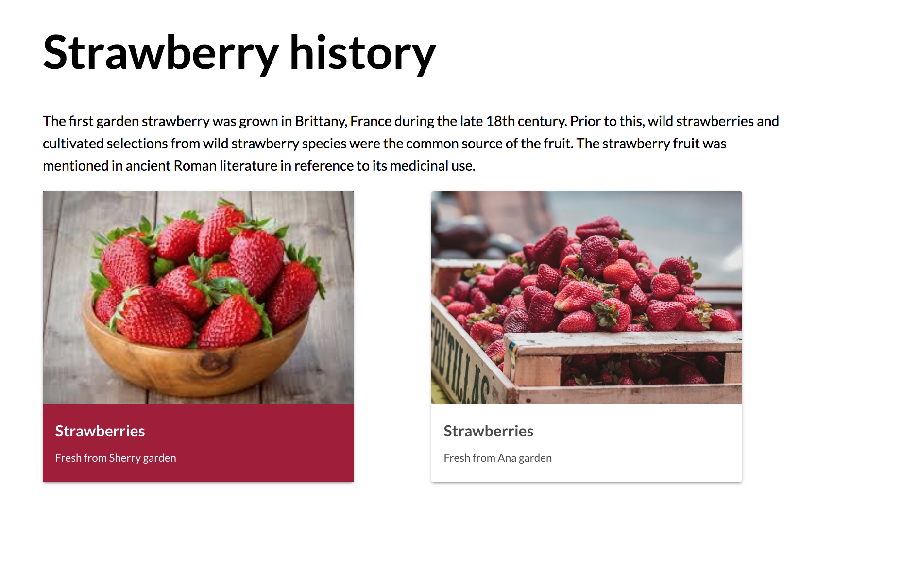
@Sherrrylst

Slide 111

We are almost done!
✅ Web components fundamentals
✅ Create a web component
✅ Create a web component with Angular
✅ How to build an Angular element
✅ Add a web component to an existing Angular project
@Sherrrylst

Slide 112

Web Components rock?
@Sherrrylst
Notes:
Yes they rock because the allow maxim interoperability.
You can now create the with Frameworks so no need to worry about tooling.
Success Stories:
EA success story
Stencil success story
ING success story -> banking

Slide 113

Yes they DO!
Maximum interoperability
Support from Frameworks (Tooling)
Many success stories
Browsers are ready
@Sherrrylst

Slide 114
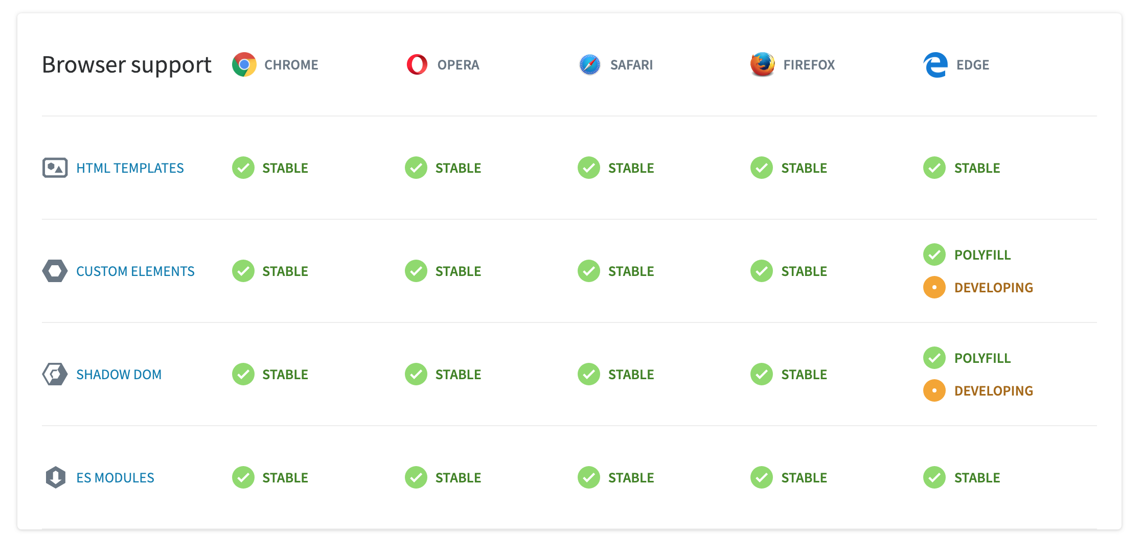
@Sherrrylst
*https://webcomponents.org
Notes:
1st class citizen of web

Slide 115

What’s next?
@Sherrrylst

Slide 116

lit-html
Check out: https://youtu.be/Io6JjgckHbg
@Sherrrylst
Notes:
Future is bright, we are going towards shipping less code over the network to our user because of using the native browser support
Our dream is to have something like JSX and there is work going on in the W3C to create a Template Instantiation spec as proposed by Apple and supported by Google
Google have done some prototyping and came up with the lit-html project which brings something like JSX to the browser without requiring any transpiling.
We really liked this and decided to use it in our final example - the future looks great and we see the whole web platform coming together
https://youtu.be/Io6JjgckHbg

Slide 117

What is lit-html?
Small library
<template> in JS with template literal
Extremely fast (Partial update)
Customizable and extensible (Directives)
🛠 Status: In Development
@Sherrrylst
Notes:
Efficient
lit-html is extremely fast. It uses fast platform features like HTML <template> elements with native cloning.
Unlike VDOM libraries, lit-html only ever updates the parts of templates that actually change - it doesn’t re-render the entire view.
Extensible
lit-html is extremely customizable and extensible. Directives customize how values are handled, allowing for asynchronous values, efficient keyed-repeats, error boundaries, and more. lit-html is like your very own a template construction kit.

Slide 118
lit-html
import { render, html } from 'lit-html';
class BbRedStrawberryElement extends HTMLElement {
constructor() {
super();
const template = document.createElement("template");
this.attachShadow({ "mode": "open" });
this.shadowRoot.appendChild(template.content.cloneNode(true));
}
}
@Sherrrylst

Slide 119
lit-html
connectedCallback() {
render(this._render(this), this.shadowRoot);
}
@Sherrrylst

Slide 120
lit-html
connectedCallback() {
render(this._render(this), this.shadowRoot);
}
// Defines element markup
_render({ img, title, description, productPrice, color }) {
return html`
@Sherrrylst

Slide 121
lit-html
<div class="main-container">
<div id="photo">
<img src=${ img || "missing.jpg" } alt=${ title || ‘N/A’ }></img>
</div>
<div id="info">
<h3 id="title" aria-label="product title">${ title || 'N/A' }</h3>
${ description ? html`<p id="description" aria-label="product description">${ description || 'N/A' }
</p>` : '' }
${ productPrice ? html` <p id="price" aria-label="product price">${ productPrice } / kilo</p>` : '' }
</div>
</div>

Slide 122
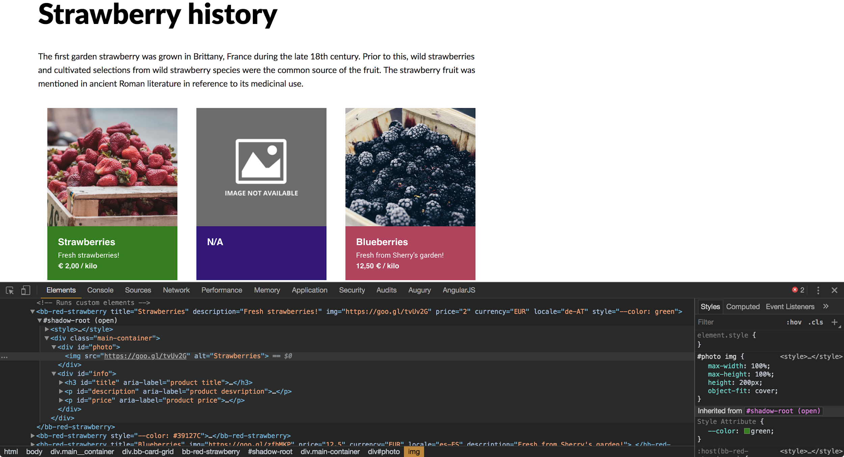

Slide 123

lit-element
Check out: https://youtu.be/ypPRdtjGooc
@Sherrrylst
Notes:
Future is bright, we are going towards shipping less code over the network to our user because of using the native browser support
Check out: https://youtu.be/ypPRdtjGooc

Slide 124

What is lit-element?
Base class for creating web components
Uses lit-html to render into the element’s
Shadow DOM
React to changes
Extremely fast & light
🛠 Status: In Development
@Sherrrylst
Notes:
Efficient
lit-html is extremely fast. It uses fast platform features like HTML <template> elements with native cloning.
Unlike VDOM libraries, lit-html only ever updates the parts of templates that actually change - it doesn’t re-render the entire view.
Extensible
lit-html is extremely customizable and extensible. Directives customize how values are handled, allowing for asynchronous values, efficient keyed-repeats, error boundaries, and more. lit-html is like your very own a template construction kit.

Slide 125
lit-element
import { litElement, html } from 'lit-html';
class BbRedStrawberryElement extends litElement {
static get properties() {
return {
title: { type: String },
description: { type: String },
currency: { type: String },
price: { type: String },
img: { type: String }
}
}
}
@Sherrrylst
Notes:
https://codepen.io/sherrrylst/pen/zmERBz

Slide 126
lit-element
render() {
return html`
<div class="main-container">
<div id="photo">
<img src=${ img || "missing.jpg" } alt=${ title || ‘N/A’ }></img>
</div>
<div id="info">
<h3 id="title" aria-label="product title">${ title || 'N/A' }</h3>
${ description ? html`<p id="description" aria-label="product description">
${ description || 'N/A' }
</p>` : '' }
${ productPrice ? html` <p id="price" aria-label="product price">
${ productPrice } / kilo</p>` : '' }
</div>
</div> `
}
Notes:
https://codepen.io/sherrrylst/pen/zmERBz

Slide 127
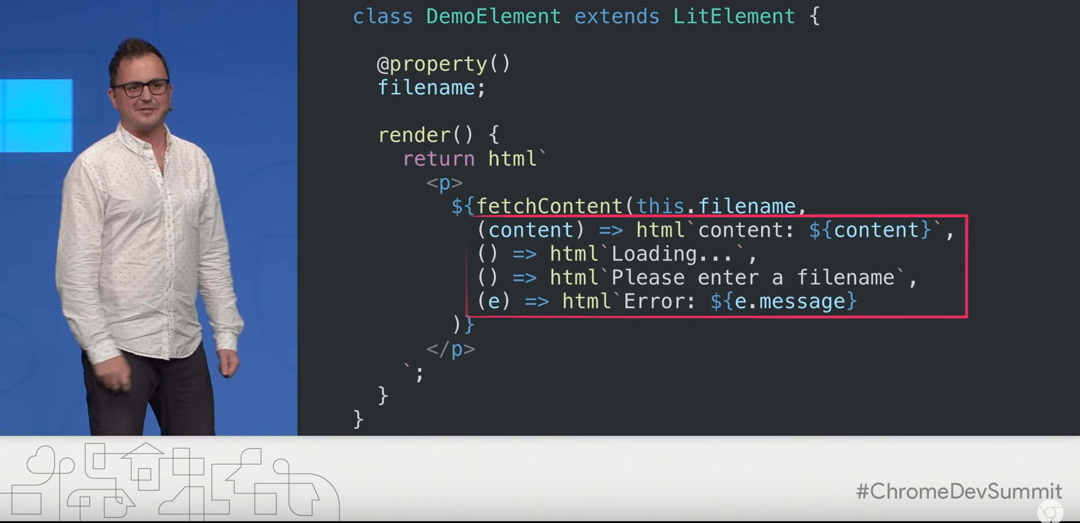
lit-element
Check out: https://youtu.be/ypPRdtjGooc
@Sherrrylst
Notes:
Future is bright, we are going towards shipping less code over the network to our user because of using the native browser support
Check out: https://youtu.be/ypPRdtjGooc

Slide 128

CSS Shadow Parts
::part()
Check out: https://meowni.ca/posts/part-theme-explainer/
@Sherrrylst
Notes:
This specification defines the ::part() pseudo-element, which allows an author to style specific, purposely exposed elements in a shadow tree from the outside page’s context. In combination with custom properties, which let the outside page pass particular values (such as theme colors) into the component for it to do with as it will, these pseudo-elements allow components and the outside page to interact in safe, powerful ways, maintaining encapsulation without surrendering all control.

Slide 129
::part
<x-foo>
#shadow-root
<div part="some-box"><span>...</span></div>
<input part="some-input">
<div>...</div> /* not styleable
</x-foo>
Check out: https://meowni.ca/posts/part-theme-explainer/
@Sherrrylst

Slide 130
::part
At a document which has <x-foo>:
x-foo::part(some-box) { … }
x-foo::part(some-box):hover { … }
x-foo::part(some-input)::placeholder { … }
Check out: https://meowni.ca/posts/part-theme-explainer/
@Sherrrylst

Slide 131
Web Components do ROCK!
@Sherrrylst

Slide 132
Angular ♥ Web Components
@Sherrrylst

Slide 133



Sherry List
@SherrryLst
Ana Cidre
@AnaCidre_

Slide 134

Azure for JavaScript developers
https://aka.ms/AA413rz

Slide 135
Best practices
https://w3ctag.github.io/webcomponents-design-guidelines/
https://github.com/webcomponents/gold-standard/wiki
https://developers.google.com/web/fundamentals/web-components/best-practices
@Sherrrylst

Slide 136
Sources
https://www.softwarearchitekt.at/post/2018/07/13/angular-elements-part-i-a-dynamic-dashboard-in-four-steps-with-web-components.aspx
https://meowni.ca/posts/part-theme-explainer/
https://medium.com/google-developer-experts/are-web-components-a-thing-5a116b1da7e4
https://www.telerik.com/blogs/web-components-101-an-introduction-to-web-components
https://www.softwarearchitekt.at/post/2019/01/27/building-angular-elements-with-the-cli.aspx
@Sherrrylst

